Slide 1
OOPS IN PYTHON

Slide 2
WHAT IS OOPS
Object Oriented programming is a programming style that is associated with the concept of Class, Objects and various other concepts revolving around these two, like Inheritance, Polymorphism, Abstraction, Encapsulation etc.
OOP is designed in such a way that one should focus on an object while programming and not the procedure. An object can be anything that we see around us. It can be a human (that has some properties like - name, address, DOB and so on), a chair (portrayed by size, material, cost etc), a school (depicted by place, student strength, results) etc.
Object oriented programming brings programming close to real life, as we are always dealing with an object, performing operations on it, using it's methods and variables etc.

Slide 3
EXAMPLE
Let us try to understand a little about all these, through a simple example. Human Beings are living forms, broadly categorized into two types, Male and Female. Right? Its true. Every Human being(Male or Female) has two legs, two hands, two eyes, one nose, one heart etc. There are body parts that are common for Male and Female, but then there are some specific body parts, present in a Male which are not present in a Female, and some body parts present in Female but not in Males.
All Human Beings walk, eat, see, talk, hear etc. Now again, both Male and Female, performs some common functions, but there are some specifics to both, which is not valid for the other. For example : A Female can give birth, while a Male cannot, so this is only for the Female.
let's see how all this is related to Python and OOPS.

Slide 4
Class
Here we can take Human Being as a class. A class is a blueprint for any functional entity which defines its properties and its functions. Like Human Being, having body parts, and performing various actions.
Inheritance
Considering HumanBeing a class, which has properties like hands, legs, eyes etc, and functions like walk, talk, eat, see etc. Male and Female are also classes, but most of the properties and functions are included in HumanBeing, hence they can inherit everything from class HumanBeing using the concept of Inheritance. Objects
My name is karthigaa, and I am an instance/object of class Male. When we say, Human Being, Male or Female, we just mean a kind, you, your friend, me we are the forms of these classes. We have a physical existence while a class is just a logical definition. We are the objects.
Abstraction
Abstraction means, showcasing only the required things to the outside world while hiding the details. Continuing our example, Human Being's can talk, walk, hear, eat, but the details are hidden from the outside world. We can take our skin as the Abstraction factor in our case, hiding the inside mechanism.

Slide 5
Encapsulation
This concept is a little tricky to explain with our example. Our Legs are binded to help us walk. Our hands, help us hold things. This binding of the properties to functions is called Encapsulation.
Polymorphism
Polymorphism is a concept, which allows us to redefine the way something works, by either changing how it is done or by changing the parts using which it is done. Both the ways have different terms for them.

Slide 6
CLASS

Slide 7
Creating object for a class
Class is mere a blueprint or a template. No storage is assigned when we define a class. Objects are instances of class, which holds the data variables declared in the class and the member functions work on these class objects.
To create an object, all we have to do is:
myObject = MyClass()
where, MyClass is the name of the class and myObject is the object variable
As you can see, we simply specified the object's name and we called a function which had the same name as of the class to which it belongs.
Do you remember how we were able to initialize a list by writing
myList = list(). Similar is the case here, we have created a user-defined data type(a class) called MyClass, and in order to inform python that myObject variable will be of that datatype, we make a call to this function.

Slide 8
Time for an Example
Let's write a small python program in which we will define a class with one variables and two methods, and then we will create an object of that class and will try to access the variable and member functions.
class Apollo:
# define a variable
destination = "moon"
# defining the member functions
def fly(self):
print "Spaceship flying..."
def get_destination(self):
print "Destination is: " + self.destination
We have defined a class with name Apollo. As you can see that in the function get_destination we have written self.destination this will give the value stored in the variable destination for the object for which the function get_destination will be called.

Slide 9
create two objects for this class. So to create objects, we know what to do,
class Apollo:
# define a variable
destination = "moon"
# defining the member functions
def fly(self):
print "Spaceship flying..."
def get_destination(self):
print "Destination is: " + self.destination
# 1st object
objFirst = Apollo()
# 2nd object
objSecond = Apollo()
Now we have defined two objects for our class. As of now, both our objects have a variable destination in them, which is assigned the value "moon".

Slide 10
To access any member variable or a member function using the object, we use a . (dot), as shown below.
class Apollo:
# define a variable
destination = "moon"
# defining the member functions
def fly(self):
print "Spaceship flying..."
def get_destination(self):
print "Destination is: " + self.destination
# 1st object
objFirst = Apollo()
# 2nd object
objSecond = Apollo()
# lets change the destination for objFirst to mars
objFirst.destination = "mars“
In the code above, we have now updated the value for the variable destination to "mars" for the object objFirst

Slide 11
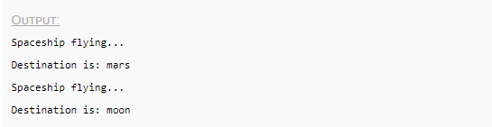
Now let's call the member functions.
class Apollo:
# define a variable
destination = "moon"
# defining the member functions
def fly(self):
print "Spaceship flying..."
def get_destination(self):
print "Destination is: " + self.destination
# 1st object
objFirst = Apollo()
# 2nd object
objSecond = Apollo()
# lets change the destination for objFirst to mars
objFirst.destination = "mars"
# objFirst calling fly function
objFirst.fly()
# objFirst calling get_destination function
objFirst.get_destination()
# objSecond calling fly function
objSecond.fly()
# objSecond calling get_destination function
objSecond.get_destination()

Slide 12
CONSTRUCTOR

Slide 13
What is a Constructor?
First, by simply defining it inside the class and maybe even initialize it with some value, then and there, pretty much like:
class Example:
myVariable = "some value“
Second way is to declare them inside any function of the class, using the self keyword. Also, it is possible to assign values to the variables while declaring them but sometimes it may happen that the values of these variables may vary for different objects of the same class. In such cases, you'll have to go for assigning values to the variables after the object creation.
Again, this can be done in two ways. First, by calling each variable direct from the object, using the dot . symbol, like:
>>> myObject.myVariable = "some other value“
or we can also ask user for an input:
>>> myObject.myVariable = raw_input()

Slide 14

Besides this we can also assign/modify values of our variables inside class functions using the selfkeyword.
class Example:
def anotherFunction(self, parameter1): self.myVariable = parameter1 # or by calling for a user input
self.myVariable = raw_input()
If we have such a function defined in our class, then the object's variables can be initialized or re-initialised by calling the anotherFunction() method and passing the desired value as parameter to this method/function.
>>> myObject = Example()
>>> myObject.anotherFunction("Amazing Spiderman")
>>> print myObject.myVariable

Slide 15
As it can be seen, this was a usual user-defined function inside Example class which is utilising parameters to initialize the variable. The concept is fairly simple here. Although, there exists something better, which uses pretty much the same principle and is a defined standard. It's known as a Constructor. Constructor is a special type of function that is called automatically whenever an object of that class is created. For example,
>>> myObject = Example()
By writing Example() in the code above, we are informing python that myObject is an object of class Example. And that is exactly when the constructor of that class is called.
But what will it do? Well, generally, the constructors are used to initialize the variables of the class for an object(instance), although it can perform some other tasks as well, like checking if there are enough resources, if the value used to initialize any variable is valid or not, etc.

Slide 16
Defining Constructor method in a class
In python, the object creation part is divided into two parts:
Object Creation
Object Initialisation
Object Creation
Object creation is controlled by a static class method with the name __new__. Hence when you call Example(), to create an object of the class Example, then the __new__ method of this class is called. Python defines this function for every class by default, although you can always do that explicitly too, to play around with object creation.
class Example:
myVariable = "some value"
simpleObj = Example()
print type(simpleObj)

Slide 17
Object Initialisation
Object initialisation is controlled by an instance method with the name __init__ and which is also generally called as a Constructor. Although, both __new__ and __init__ together forms a constructor.
Once the object is created, you can make sure that every variable in the object is correctly initialised by defining an __init__ method in your class, which pretty much means init-iate.
Thus, it doesn't matter what the class name is, if you want to write a constructor(to initialise your object) for that class, it has to be the __init__() method. Within this function, you're free to declare a class variable(using self) or initialize them. Here is a quick example for our Example class with __init__ method:
class Example:
def __init__(self, value1, value2):
self.myVariable1 = value1
self.myVariable2 = value2
print "All variable initialized"

Slide 18
Once you define the __init__ method in a class, then while creating an object, when you call Example(), you can provide all the necessary parameters required for the object's variables, because when we call Example(), behind the scene python calls the __init__ function for the created object automatically.
This is how the code will look:
>>> myObj = Example("first variable", "second variable")

Slide 19
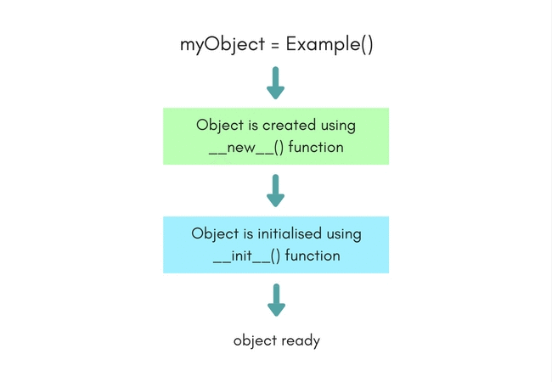

Slide 20
Inheritance in Python

Slide 21
Inheritance in Python
Inheritance is one of the most important aspects of Object Oriented Programming. While programming, many a times, situations arise where we have to write a few classes with some common features and some unique, class-specific features, which include both variables and methods.
In such situations, as per object oriented programming, we can take out the common part and put it in a separate class, and make all the other classes inherit this class, to use its methods and variables, hence reducing re-writing the common features in every class, again and again.
The class which inherits another class is generally known as the Child class, while the class which is inherited by other classes is called as the Parent class.
Ofcourse, you must only use this for the related classes only, for example, you can define a class LivingOrganism with all the basic features of a living organism defined in it, like breathe, eat etc. Now this class can easily be re-used by another class Animals and HumanBeings, as both of these shares the features.
Also, at times, Inheritance is used to simplify big classes with a lot of variables and methods, into smaller classes by breaking down the functionality into core features and secondary features. The core features are generally kept in the parent class.

Slide 22
Time for an Example
Let's take simple example. Animals can be divided into multiple types like reptiles, mammals, amphibians etc. While they all are different physically and biologically, there are many characteristics that are common amongst them. So now, we will define a parent class with name Animal, which will have some basic properties and functions related to animals.
And then we will define classes for various other types, and all those classes will also inherit the class Animal.
Here we have the Animal class.
class Animal:
# properties
multicellular = True
# Eukaryotic means Cells with Nucleus
eukaryotic = True
# functions
def breath()
def feed()

Slide 23
Now let's define a class for Mammals. As mammals are animals with warm blood, who produce milk for their infants etc, hence our Mammal class will look like,
class Mammal(Animal):
# properties
haveMammaryGland = True
def warmBlood = True
# functions
def produceMilk()

Slide 24
In case we want to create another class for Amphibians too, then
class Amphibian(Animal):
# properties
liveInWater = True
# functions
def metamorphosis()
As the classes Mammals and Amphibian both inherit the class Animal, hence they will have the properties and functions defined in the class Animal.
Hence, now any object of Amphibian class, say Frog, will have the properties: multicellular(from class Animal), eukaryotic(from class Animal), liveInWater(from class Amphibian), and would be able to breath(), feed() and do metamorphosis().

Slide 25

And how all this can be written as code, if we create an object, say Frog:
>>> Amphibian Frog = Amphibian()
>>> Frog.breath() # calling function defined in Animal class
>>> Frog.metamorphosis() # calling function defined in Amphibian class
>>> print Frog.liveInWater
Benefits of using Inheritance
Here are a few main advantages of using Inheritance in your programs.
Less code repeatition, as the code which is common can be placed in the parent class, hence making it available to all the child classes.
Structured Code: By dividing the code into classes, we can structure our software better by dividing functionality into classes.
Make the code more scalable.

Slide 26
Accessing Parent Class Element in Child Class
While working in a child class, at some point you may have to use parent class's properties or functions. In order to access parent class's elements you can use the dot . operator.
Parent.variableName
Mentioned above is how you can access the variable, or in case you need to call parent class's function then,
Parent.functionName()
Where Parent is the name of our parent class, and variableName and functionName() are its variable and function respectively.
Below is an example, we have a simple example to demonstrate this:
class Parent:
var1 = 1
def func1(self):
# do something here
class Child(Parent):
var2 = 2
def func2(self):
# do something here too
# time to use var1 from 'Parent'
myVar = Parent.var1 + 10
return myVar

Slide 27
METHOD OVERRIDING

Slide 28
Python Method Overriding Example
There is a parent class named Animal:
class Animal:
# properties
multicellular = True
# Eukaryotic means Cells with Nucleus
eukaryotic = True
# function breathe
def breathe(self):
print("I breathe oxygen.")
# function feed
def feed(self):
print("I eat food.")

Slide 29
Let's create a child class Herbivorous which will extend the
class Herbivorous(Animal):
# function feed
def feed(self):
print("I eat only plants. I am vegetarian.")
In the child class Herbivorous we have overridden the method feed().

Slide 30
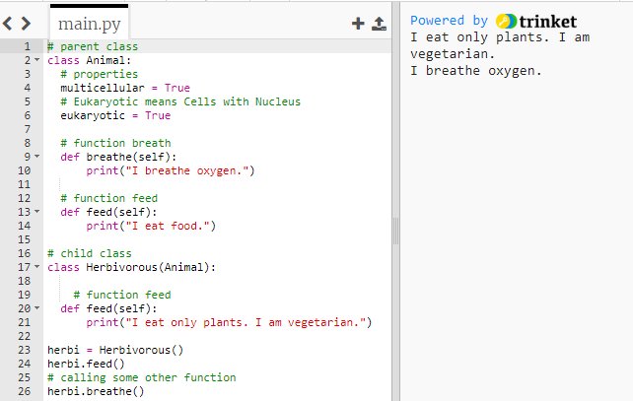
So now when we create an object of the class Herbivorous and call the method feed() the overridden version will be executed.
herbi = Herbivorous()
herbi.feed()
# calling some other function
herbi.breathe()

